Slide 1

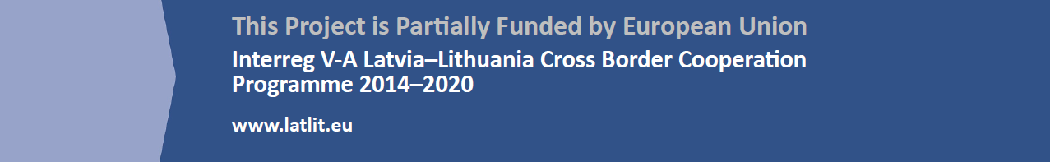
Mentoring for youth entrepreneurship support. BONUS LT-LV
This publication has been produced with the financial assistance of the European Union. The contents of this publication are the sole responsibility of Kaunas university of technology, Daugpils university and PI PVC and can under no circumstances be regarded as reflecting the position of the European Union.

Slide 2
BUSINESS PROCESSES
What is a value chain?
How enterprise‘s activity is being organized?

Slide 3
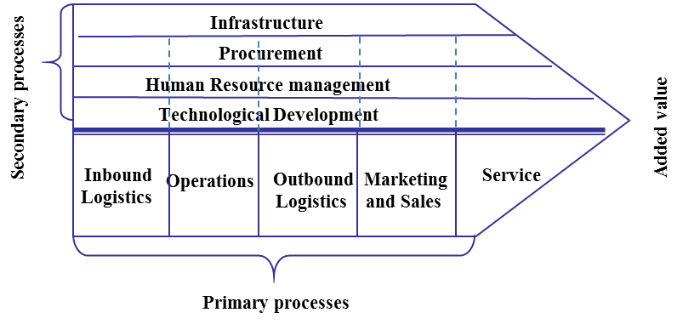
ENTERPRISE‘S VALUE CHAIN
Enterprise‘s value chain
– is internal processes, which the enterprise performs while creating, producing, selling, supplying products to clients and servicing them
Porter‘s value chain

Slide 4
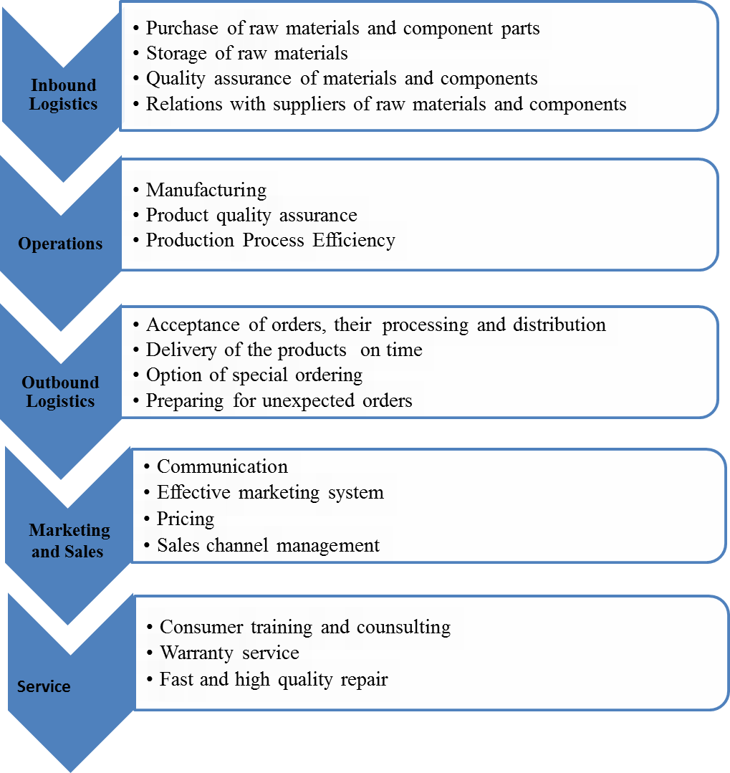
PRIMARY PROCESSES

Slide 5
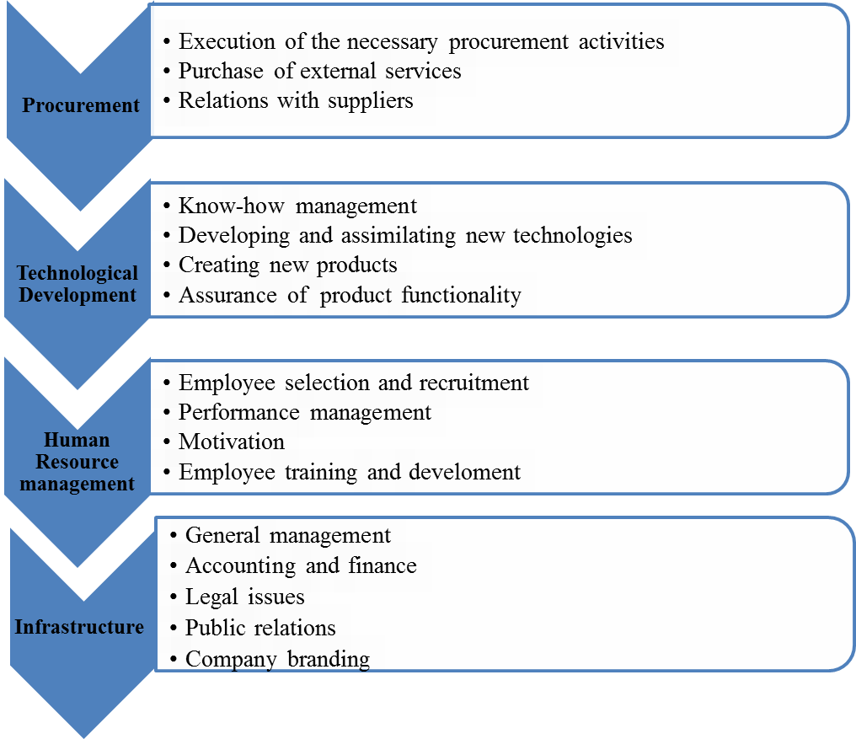
SECONDARY PROCESSES

Slide 6
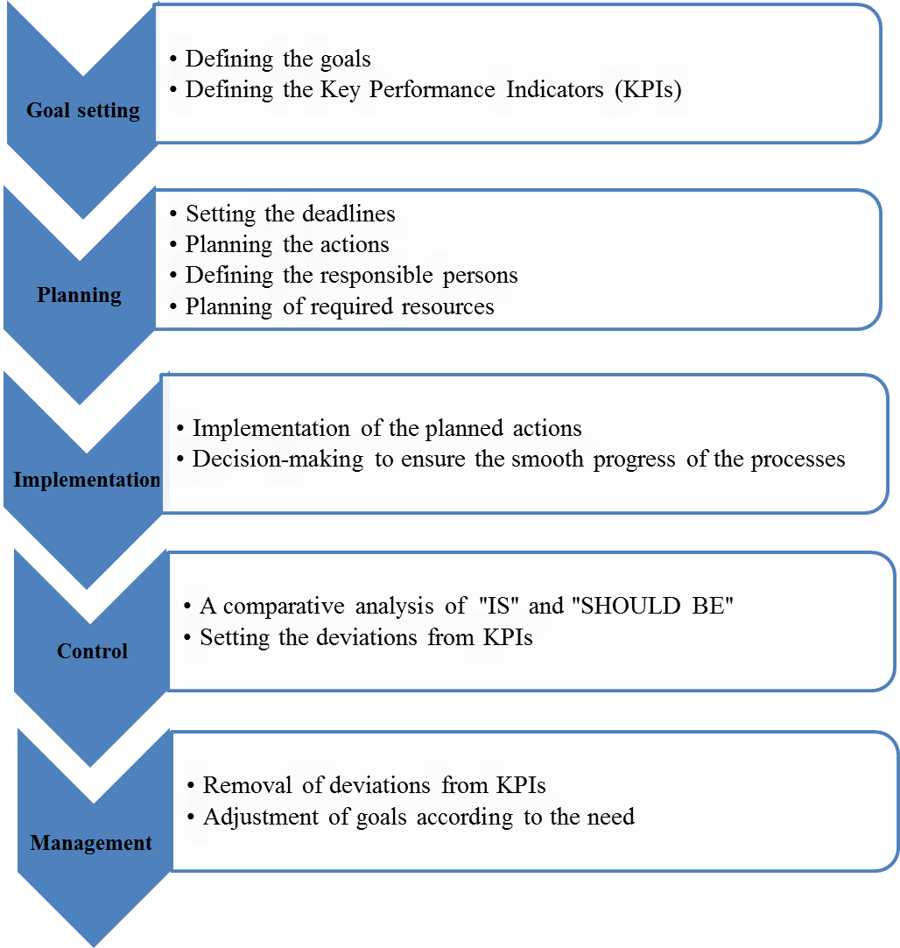
STAGES OF ENTERPRISE’S PROCESSES MANAGEMENT

Slide 7
STAGES OF ENTERPRISE’S PROCESSES MANAGEMENT
Goals setting
Goals show what the enterprise wants to achieve in future. it is important to follow a principle SMART during formulation of the goals :
S (specific) –clear. It has to be told clearly what should be achieved, for example, to increase market‘s part, to decrease production costs, to implement new technologies
M (measurable) – – measurable. The goal should include quantitative or qualitative measures of goal achievement
A (agreed upon) – coordinated. Goals have to be not contradicting each other
R (realistic) – real. Goals must be formulated by assessing available resources and competencies
T (time-bound) – reasoned in time. There must be enough time to achieve the goals, however, there should be not too much time to avoid indulgence

Slide 8
STAGES OF ENTERPRISE’S PROCESSES MANAGEMENT
Planning
Planning describes what actions the enterprise or its subdivision should take to reach the goals raised to them
Plans can be created by following three principles:
Planning from top to bottom. Plans are being created at the enterprise’s highest management level and given to medium and lowest management levels
Planning from bottom to top. The goals and instruments to reach them are being formed at the lowest management level
Countermining. This is combination of the first and second planning principles, however, here the main role goes to the medium management level that has to assess if the operational plans created at the lowest management level echo and concretize the strategical plans created at the highest management level

Slide 9
STAGES OF ENTERPRISE’S PROCESSES MANAGEMENT
Implementation
The highest management level is responsible for implementation of strategical plans of entire organization
The medium and lowest management levels are responsible for implementation of tactical and operational plans of particular areas

Slide 10
STAGES OF ENTERPRISE’S PROCESSES MANAGEMENT
Control
Control allows to assess if the situation „IS“ corresponds the situation „SHOULD BE“
Control types:
Control of results. As was mentioned earlier, strategical, tactical and operational goals must be measured, therefore, control of results indicates if the goals are being reached
Control of a course, resources. There is a control if resources and terms foreseen in the plans are not being exceeded. This control indicates effectiveness of processes

Slide 11
STAGES OF ENTERPRISE’S PROCESSES MANAGEMENT
Management
Management foresees actions required to eliminate interferences:
Reaction to deviations
Foresight of possible changes in the market
Correction the plans according to changed situation :
  Correction of target indicators
  Correction of actions
  Correction of resources
  Correction of deadlines

Slide 12
Mentoring for youth entrepreneurship support. BONUS LT-LV
This publication has been produced with the financial assistance of the European Union. The contents of this publication are the sole responsibility of Kaunas university of technology, Daugpils university and PI PVC and can under no circumstances be regarded as reflecting the position of the European Union.

