Slide 1


Mentoring for youth entrepreneurship support. BONUS LT-LV
This publication has been produced with the financial assistance of the European Union. The contents of this publication are the sole responsibility of Kaunas university of technology, Daugpils university and PI PVC and can under no circumstances be regarded as reflecting the position of the European Union.

Slide 2

EMPLOYEE RELATIONS
How is forming a balance of labour force supply and demand?
What main legal documentation regulates a labour relationship?
What are possible strategies of relationship with employees, what are their advantages and disadvantages?
How to stimulate employees’ engagement?

Slide 3
LABOUR FORCE DEMAND AND SUPPLY
Factors influencing labour force demand and supply:
Number of employers willing to recruit the employees with particular competence (labour force demand)
Number of employees with particular competence and willing to be recruited (labour force supply)
Wage that plays a role of mediator

Slide 4
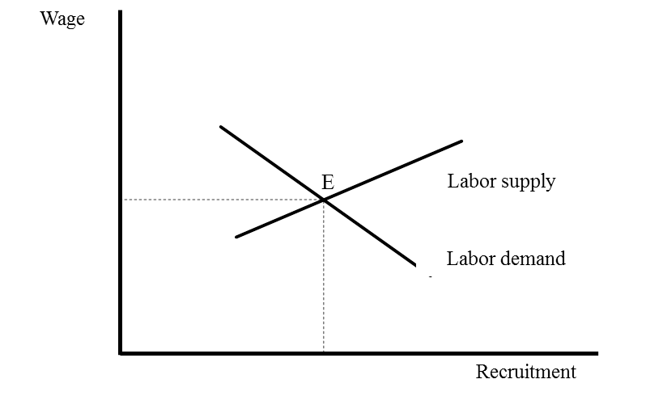
LABOUR FORCE DEMAND AND SUPPLY
E – balance between labor demand and supply

Slide 5
  TENDENCIES OF LABOUR MARKET DEVELOPMENT
Labour market development is determined by many factors:
Country‘s economic political situation
Globalization tendencies
Demographic environment
Technological environment
Cultural environment

Slide 6
REGULATION OF LABOUR RELATIONSHIP
Documents governing labor relations:
Code of Labour
Governed issues :
Types of labour contracts
Necessary and additional conditions of labour contracts
Conclusion, execution and termination of labour contract
Work and rest time
Wage
Restitution
Employees‘ safety and health
Other important areas of labour relationship
The enterprise with regard to requirements of the Code of Labour makes a collective and / or individual labour contract.

Slide 7
REGULATION OF LABOUR RELATIONSHIP
Documents governing labor relations:
Enterprise‘s collective contract
It is a written agreement between the employer and the collective of the enterprise‘s employees regarding the work, payment for work and other social and economic conditions.
Labour contract
It is an agreement between employee and employer by which the employee commits to perform a job of particular profession, speciality, qualification or to take a particular position by obeying the order determined in the enterprise, and the employer commits to give a job determined in the contract, to pay a stipulated wage to the employee and to ensure working conditions determined by the labour laws, other legislation, collective contract and agreement of the parts.
Other laws regulating labor relations
The Law on Equal Treatment and the Law on Women and Men Equal Treatment
The Law on Legal protection of Personal Data

Slide 8
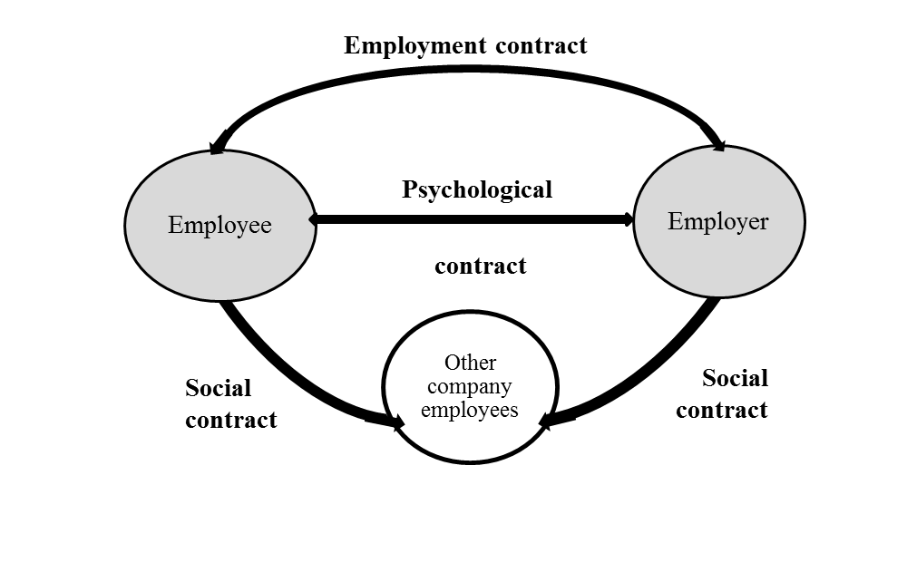
  LEGAL AND PSYCHOLOGICAL CONTRACT BETWEEN EMPLOYER AND EMPLOYEE

Slide 9
  STRATEGY OF RELATIONSHIP WITH EMPLOYEES
4 different opinions of how a strategy of relationship with employees could be formed:
Hostility – organization decides what it wants and requires from employees for thoughtless execution
Traditional attitude – a support of relationship with employees, but when management presents proposals, they are being reacted in the name of employees only by the chosen ones.
Cooperation – an organization engages the employees into formation and implementation of organizational policy, but keeps the right of final decision
Division of authority – employees are engaged into everyday decisions and strategical ones

Slide 10
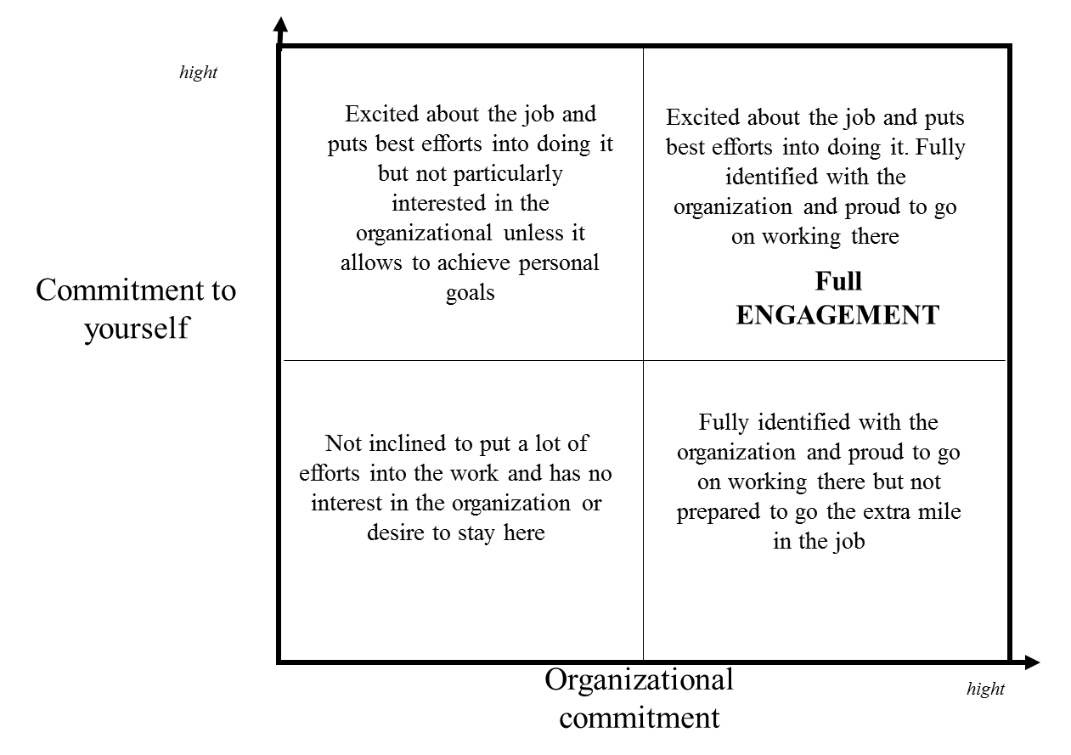
  ENGAGEMENT OF EMPLOYEES

Slide 11
  ENGAGEMENT OF EMPLOYEES
Factors that allow increasing of employees‘ engagement
Work character. Interesting and pleasing work for the employee increases engagement per se. Work challenges allowing the employee to feel own competency and direction of development, responsibility enables a perception of importance of the performed work
Work environment. If physical work environment nowadays is being treated as hygiene, then employees‘ engagement is being especially stimulated by the labour relationship in the collective, colleagues cooperation
Leadership. Manager‘s support and stimulation is a very important factor because, thus, there is shown a manager‘s assent to employee‘s initiative and engagement
Possibility to develop. Possibility to develop engages the employee into own competence training and constant development, and is assessed by the employee as an assent
Possibility to be heard. Possibilities to express own opinion and get feedback indicate employees’ engagement into decision making

Slide 12
Mentoring for youth entrepreneurship support. BONUS LT-LV
This publication has been produced with the financial assistance of the European Union. The contents of this publication are the sole responsibility of Kaunas university of technology, Daugpils university and PI PVC and can under no circumstances be regarded as reflecting the position of the European Union.

